Slide 1
Dan Morales
Senior Copywriter & Strategic Creative
I turn complexity into work that performs in the real world.
www.danmoralescopy.com
dan@danmoralescopy.com
LinkedIn

Slide 2
How I Think
I’ve spent my career helping brands simplify ideas, sharpen messaging, and create work people actually engage with.
My experience spans integrated campaigns, digital UX, social, content systems, and brand storytelling across companies including Samsung, Oscar Mayer, AT&T, Capital One, Maxwell House, and StoneX.
I work best where clarity matters most: simplifying products, shaping campaigns, and connecting concept, UX, and execution into systems that move people.
What I Bring
Clarity. Performance. Momentum.
I simplify complexity into clear, memorable ideas
I create work that performs
I connect concept, UX, and execution into one system that moves people

Slide 3
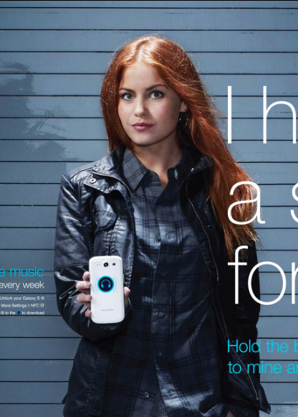
Samsung
Turned new technology into an elegant, human connection
Samsung needed digital and social campaigns that could simplify new mobile technology while supporting the launch of flagship devices.
I wrote campaign, platform, and media copy that helped make complex features feel intuitive, useful, and human.
The work contributed to an Effie-winning campaign later recognized by WARC among the world’s smartest marketing campaigns.
Results
Effie Award Winner
Featured by WARC
Simplified emerging NFC technology through elegant storytelling
Helped establish Samsung’s Facebook tab experience as a purchase funnel

Slide 4
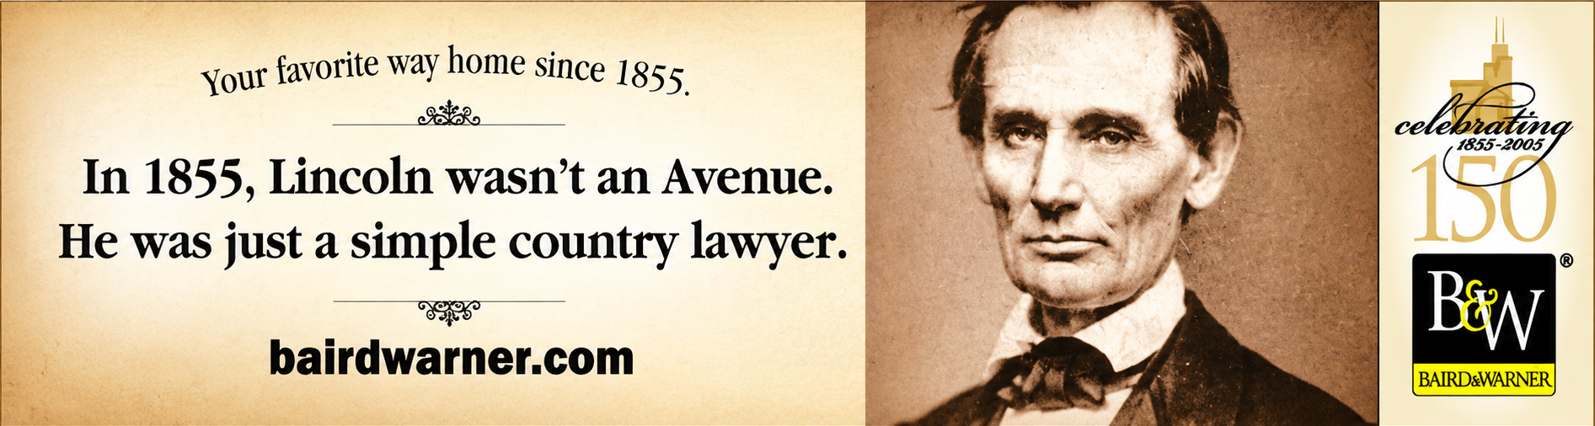
Baird & Warner
Elevated concise copy into a brand asset
Baird & Warner asked for a banner campaign celebrating 150 years of history. Instead of talking about real estate, the campaign positioned the brand as part of Chicago’s story.
Early in my career, this campaign taught me a lesson that still shapes my writing today: make every word earn its place.

Slide 5
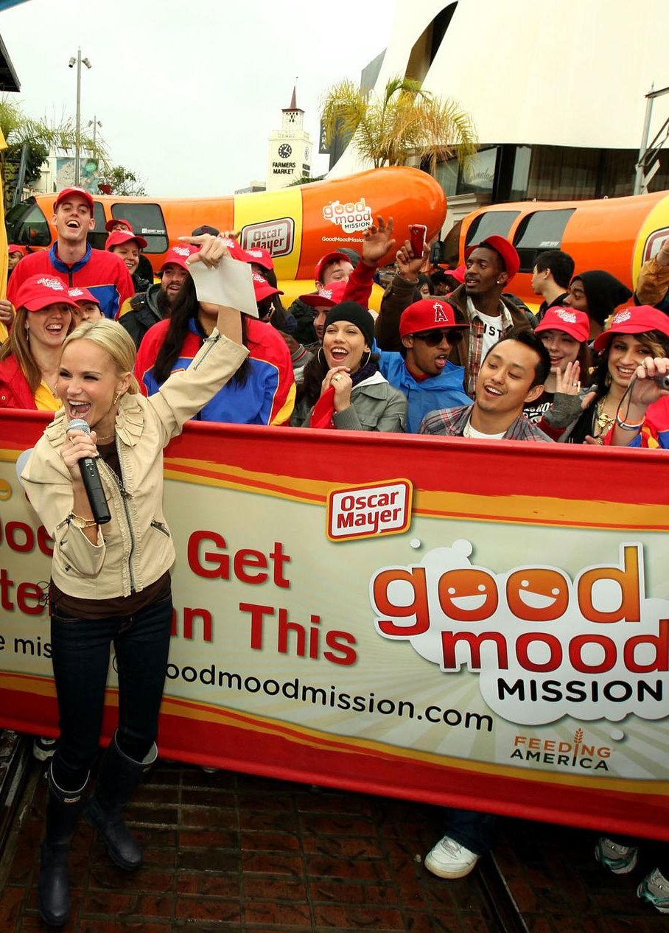
Oscar Mayer
480K+ engagements. 3M pounds of food raised.
Oscar Mayer’s Good Mood Mission invited people to share what put them in a good mood while helping support Feeding America.
The campaign blended social participation, digital engagement, and cause-driven storytelling into a simple idea people wanted to interact with and share.
Results
480,000+ unique submissions
155,000 new Facebook fans
425,000 coupons distributed
3 million pounds of food donated

Slide 6
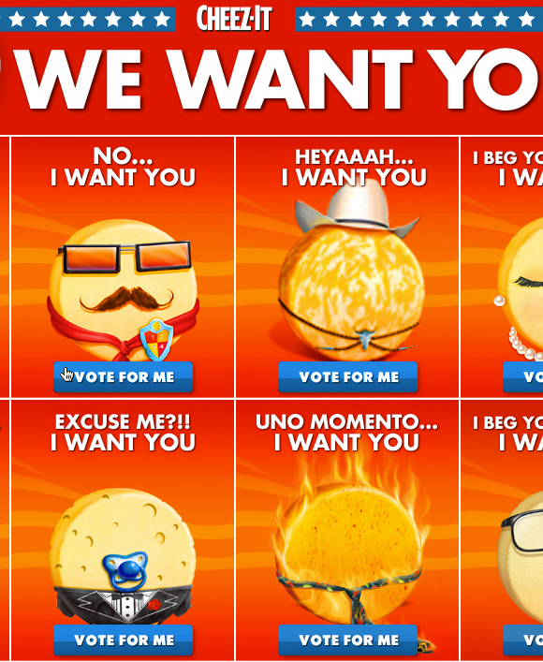
Cheez-It
Drove 66.9M votes for a variety play.
Cheez-It wanted to increase engagement across multiple flavors while energizing a passionate fan base.
We transformed a variety play into a large-scale voting experience that encouraged repeat participation, social interaction, and brand advocacy.
The campaign delivered major engagement, measurable sales lift, and industry recognition.
Results
66.9 million votes
600,000+ new Facebook fans
+25% sales lift across featured SKUs
FAB Award Winner

Slide 7
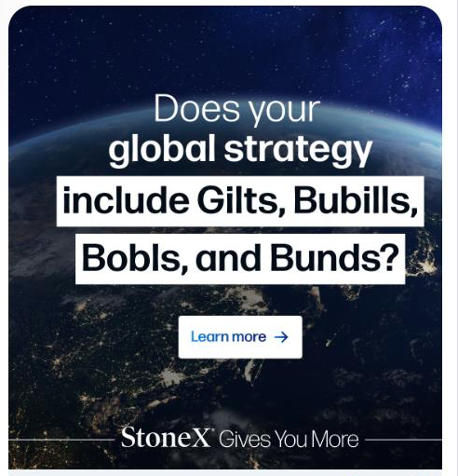
StoneX Group
Made financial products easier to understand and act on.
StoneX needed customer-first messaging that could simplify sophisticated financial products without losing credibility.
I developed campaign, PR, media, and thought leadership content designed to simplify complex offerings while supporting global business goals.
Results
Led global multi-channel campaigns
Used interesting language to cut through
Simplified financial messaging for broader audiences

Slide 8
Let’s build something.
I’m always interested in opportunities involving thoughtful creative, integrated campaigns, digital experience, and strategic storytelling.
www.danmoralescopy.com
dan@danmoralescopy.com
LinkedIn

