Slide 1
Dan Morales
Senior Copywriter & Strategic Creative
I turn complexity into work that performs in the real world.
www.danmoralescopy.com
dan@danmoralescopy.com
LinkedIn

Slide 2
How I Think
I’ve spent my career helping brands simplify ideas, sharpen messaging, and create work people actually engage with.
My experience spans integrated campaigns, digital UX, social, content systems, and brand storytelling across companies including Samsung, Oscar Mayer, AT&T, Capital One, Maxwell House, and StoneX.
I work best where clarity matters most: simplifying products, shaping campaigns, and connecting concept, UX, and execution into systems people can actually use.
What I Bring
Clarity. Performance. Momentum.
I create work that performs
I simplify complexity into clear, memorable ideas
I connect concept, UX, and execution into one system

Slide 3
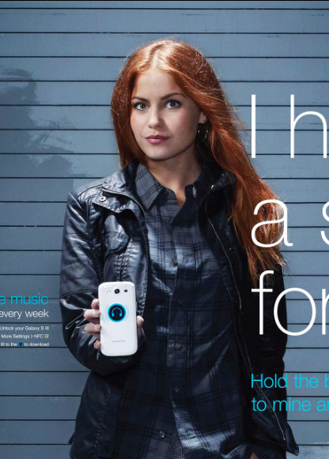
Samsung
Turned new technology into an elegant, human connection
Samsung needed digital and social campaigns that could simplify new mobile technology while supporting the launch of flagship devices.
I wrote campaign, platform, and media copy that helped make complex features feel intuitive, useful, and human.
The work contributed to an Effie-winning campaign later recognized by WARC among the world’s smartest marketing campaigns.
Results
Effie Award Winner
Featured by WARC
Simplified emerging NFC technology through elegant storytelling
Helped establish Samsung’s Facebook tab experience as a purchase funnel

Slide 4
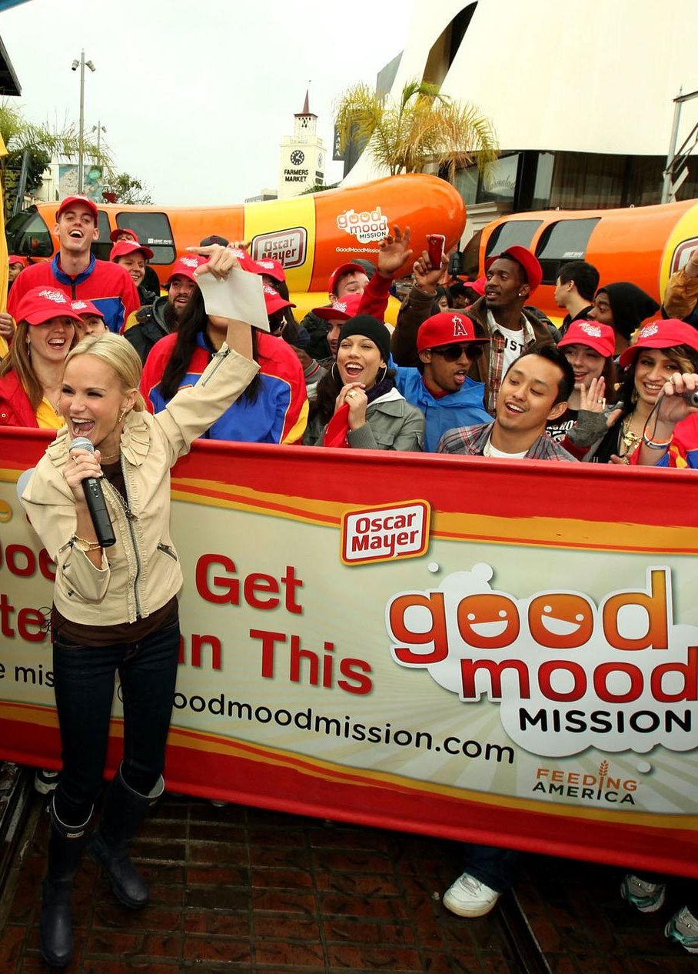
Oscar Mayer
480K+ engagements. 3M pounds of food raised.
Oscar Mayer’s Good Mood Mission invited people to share what put them in a good mood while helping support Feeding America.
The campaign blended social participation, digital engagement, and cause-driven storytelling into a simple idea people wanted to interact with and share.
I contributed campaign copy and digital experience messaging that helped turn participation into measurable engagement.
Results
480,000+ unique submissions
155,000 new Facebook fans
425,000 coupons distributed
3 million pounds of food donated

Slide 5
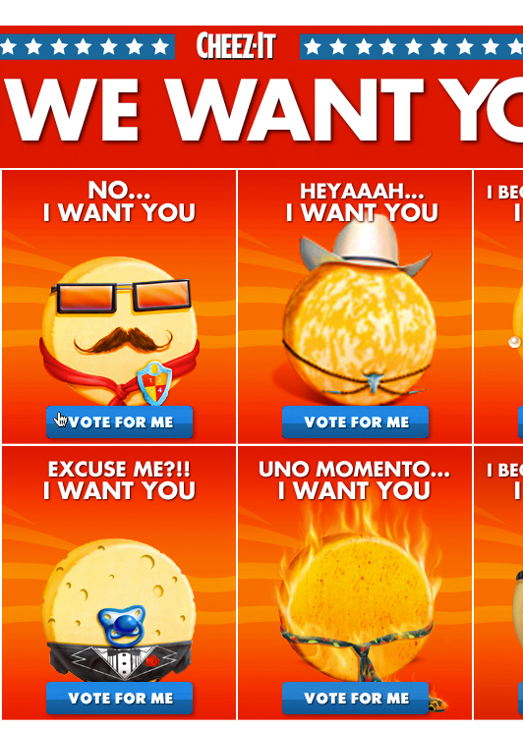
Cheez-It
Drove 66.9M votes for a variety play.
Cheez-It wanted to increase engagement across multiple flavors while energizing a passionate fan base.
We transformed a variety play into a large-scale voting experience that encouraged repeat participation, social interaction, and brand advocacy.
The campaign delivered major engagement, measurable sales lift, and industry recognition.
Results
66.9 million votes
600,000+ new Facebook fans
+25% sales lift across featured SKUs
FAB Award Winner

Slide 6
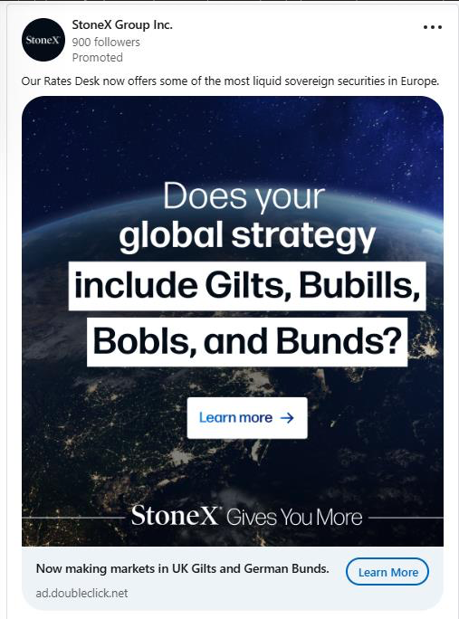
StoneX Group
Made financial products easier to understand and use.
StoneX needed customer-first messaging that could clarify sophisticated financial products without losing credibility.
I developed campaign, PR, media, and thought leadership content designed to simplify complex offerings while supporting global business goals.
Results
Led global multi-channel campaigns
Developed thought leadership and brand content
Simplified financial messaging for broader audiences

Slide 7
Let’s make some magic.
I’m always interested in opportunities involving thoughtful creative, integrated campaigns, digital experience, and strategic storytelling.
www.danmoralescopy.com
dan@danmoralescopy.com
LinkedIn

